Slide 1

EXECUTIVE PORTFOLIO PROJECT
HR Analytics
Performance Dashboard
Turning Workforce Data into Retention Strategy — Designed, Modeled, and Automated End-to-End in Microsoft Excel
Designed by: [Yasser Salem Elnakeb]
Data Analyst · Excel Business Intelligence · HR Analytics
Excel
Pivot Tables
VBA
Slicers
Dashboards
Notes:
Good morning / afternoon. Today I'll walk you through an HR Analytics Performance Dashboard I built completely from scratch in Microsoft Excel — covering everything from raw data cleaning to pivot-table modeling, KPI design, VBA automation, and a fully interactive executive dashboard. This project reflects the same kind of end-to-end thinking I'd bring to a real analytics engagement, so I'll walk through it the way I would with an HR leadership team.

Slide 2



PROJECT OVERVIEW
Why This Project, and What It Solves
The Business Problem Leadership had no single, trustworthy view of workforce health. Attrition was reported as one blended company-wide number, with no visibility into which departments, managers, or contract types were actually driving it. Why HR Analytics Matters Every HR number represents a person and a cost. Getting attrition, diversity, and tenure right is the difference between reacting to turnover and preventing it. Project Objective Build one interactive dashboard that lets HR filter, drill, and trust the numbers — replacing manual, disconnected spreadsheet reporting.
Single Source of Truth
One governed data model feeding every KPI and chart.
Actionable Insight
Surface the retention hotspots hidden inside the average.
Executive-Ready Delivery
Interactive, presentable, and built for a live leadership review.
HR Analytics Performance Dashboard
02 / 12
Notes:
This project exists because the business had a real blind spot: a single attrition percentage that looked fine on the surface, but no way to see where turnover was actually concentrated. HR analytics matters because every one of these numbers is a person and a cost — getting this right changes real retention decisions. My objective was to build one governed, interactive dashboard the business could actually trust and use in a live leadership meeting, replacing manual spreadsheet pulls.

Slide 3






THE DATASET
171 Employee Records, Six Years of History
171
7
4
Total Employee Records
Departments Tracked
Job Levels (Grades)
62 / 38
89 / 11
2020–2025
Male / Female Split
Permanent / Contract %
Years of Service Covered
Fields tracked: Employee Status · Movement Type · Department · Job Grade · Reporting Manager · Employment Type · Gender · Marital Status · Date of Joining · Date of Relieving · Tenure (Stability)
Data quality improvements applied: standardized status labels, corrected inconsistent date fields, normalized department/grade categories, and converted the source range into a structured table for reliable pivot refresh.
HR Analytics Performance Dashboard
03 / 12
Notes:
The dataset covers 171 employee records across seven departments and four job levels, spanning six years of hiring history from 2020 to 2025. Before any analysis began, I ran a full data quality pass — standardizing status labels, fixing inconsistent date fields, and normalizing category values — because a dashboard is only as trustworthy as the data underneath it.

Slide 4
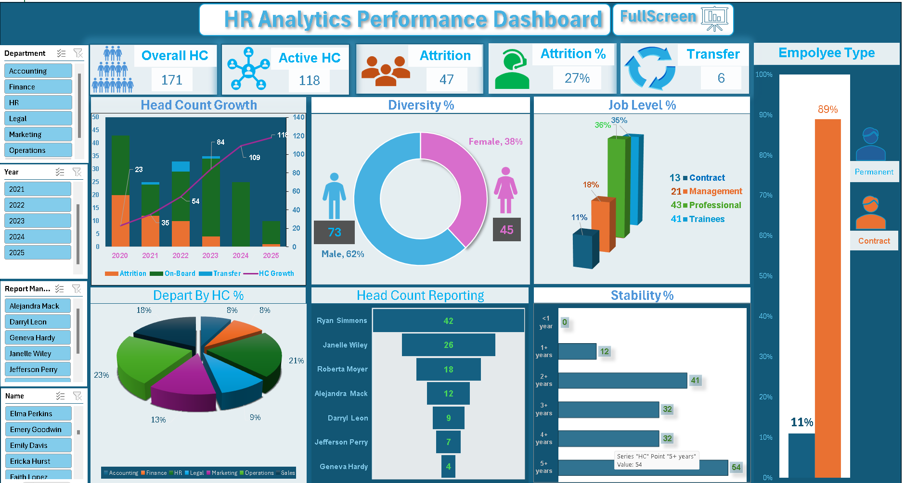



THE DASHBOARD
One Screen. Every Workforce Metric.
Slicers
Filter instantly by Name, Department, Manager, or Year — every chart updates together.
KPI Strip
Overall HC, Active HC, Attrition %, and Transfers anchored at the top for a 3-second read.
Guided Navigation
Left-rail slicers move from person → manager → time period → department.
Live executive dashboard — Excel
HR Analytics Performance Dashboard
04 / 12
Notes:
This is the dashboard itself — a single screen covering headcount, attrition, diversity, job level, department mix, manager span of control, and tenure. Every chart is connected through slicers for Name, Department, Manager, and Year, so clicking any one filter updates the entire page simultaneously. The layout was intentionally designed to guide a viewer from a specific person, to their manager, to a time period, to a department.

Slide 5






KEY PERFORMANCE INDICATORS
Ten KPIs, Each Tied to a Business Decision
Overall HC
Active HC
Attrition
Attrition %
Transfers
Total lifetime population — sizes historical hiring scale.
Today's real workforce — drives payroll & staffing plans.
Raw exit count — the base retention-cost signal.
Exit rate — triggers retention-budget decisions.
Internal moves — measures mobility vs. hard loss.
Gender Diversity
Department Mix
Job Levels
Employee Type
Stability
Representation — informs DEI sourcing strategy.
Where headcount sits — flags concentration risk.
Org pyramid shape — signals promotion pipeline health.
Permanent vs. contract — shapes cost flexibility.
Tenure distribution — reveals long-term retention.
HR Analytics Performance Dashboard
05 / 12
Notes:
Every KPI on this dashboard was chosen because it supports a specific business decision, not just because it was easy to calculate. Overall and Active Headcount separate historical scale from today's real staffing picture. Attrition and Attrition percent drive retention budget decisions. Transfers show whether the business is losing talent externally or redeploying it internally. And Stability shows whether long-term retention is genuinely strong or just looks that way on average.

Slide 6


BUSINESS INSIGHTS
What the Data Actually Revealed
Hiring outpaced retirement
27.5%
Active headcount grew 5x (23 → 118) since 2020 — growth has been fast and mostly sustained.
Attrition is concentrated, not spread evenly
Company-wide lifetime attrition rate
One department and one employment type drive a disproportionate share of all exits.
But the average hides the real story:
Manager quality outweighs team size
50.0% attrition in Accounting 43.5% attrition among contractors 8.7% attrition in Sales (most stable)
The manager with the widest span (42 reports) has the lowest team attrition of anyone.
Internal mobility is rarely used
Only 6 transfers were recorded against 47 exits — most departures are hard losses.
HR Analytics Performance Dashboard
06 / 12
Notes:
The headline attrition figure is 27.5% — on its own, that looks like a moderate, manageable number. But once I segmented it by department and employment type, a completely different picture emerged: Accounting is running attrition of 50%, and contractors are exiting at nearly double the rate of permanent staff. Meanwhile Sales, at 8.7%, is the most stable part of the business. None of this is visible in the blended company-wide average — it only shows up once you slice the data properly.

Slide 7



PROBLEMS IDENTIFIED
Seven Issues the Dashboard Surfaced
High Attrition Rate
Uneven Department Distribution
Management Shortage
High Turnover Under Specific Managers
27.5% lifetime attrition, with a 50% spike in Accounting.
Operations and HR carry the largest, and riskiest, headcount share.
Span of control ranges from 4 to 42 reports with no structural logic.
Three managers each run 36%+ team attrition.
Weak Retention Safety Valve
Low Early-Tenure Stability
Contractor Dependency Risk
Just 6 internal transfers recorded against 47 exits.
A meaningful share of hires exit before reaching two years.
Contract staff attrite at 43.5% — nearly double permanent staff.
HR Analytics Performance Dashboard
07 / 12
Notes:
Segmenting the dashboard surfaced seven distinct, addressable problems — not just 'attrition is high,' but exactly where it's concentrated: a specific department, specific managers, and the contractor population. Internal mobility is also underused as a retention lever, and the org's span of control has no consistent structural logic behind it. Each of these is something HR can act on individually, rather than one vague, company-wide attrition initiative.

Slide 8








RECOMMENDATIONS
Targeted Actions, Not a Blanket Initiative
Retention Programs
Employee Engagement
Career Development & Training
Leadership Pipeline
Focus first on Accounting and the highest-attrition manager teams.
Pulse surveys to catch disengagement before resignation.
Build a defined Trainee → Professional promotion path.
Grow a management layer under the widest-span managers.
Internal Promotions & Mobility
Exit Interview Analysis
Diversity Hiring
Succession & Performance Monitoring
A formal internal job board to raise the transfer-to-exit ratio.
Systematic exit data to convert hypotheses into evidence.
Audit sourcing channels to narrow the 62/38 gender split.
Track manager-level attrition as a standing KPI.
HR Analytics Performance Dashboard
08 / 12
Notes:
These recommendations are deliberately specific rather than generic — retention programs aimed first at Accounting and the highest-attrition managers, a formal internal mobility program to fix the transfer-to-exit imbalance, and a defined promotion pathway to relieve pressure on the bottom-heavy job-level pyramid. Predictive HR analytics is the natural next step once this foundation is in place, which leads into where I'd take this project next.

Slide 9




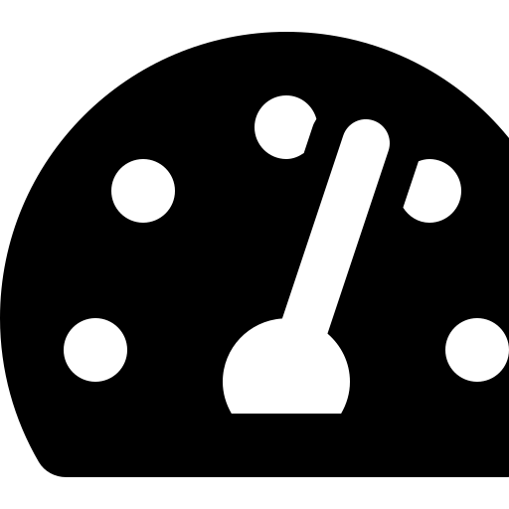
TECHNICAL CHALLENGES
Built Manually. Solved Deliberately.
Cleaning Inconsistent Data
Building 8 Linked Pivot Tables
Standardized status labels and date fields into one clean master table.
Structured each pivot to filter correctly — active-only vs. full history.
Interactive Slicers
Dashboard Layout & KPI Cards
Connected every slicer to all pivots via Report Connections for unified filtering.
Iterated layout until the whole story read in under 30 seconds.
VBA Automation
Full-Screen Presentation Mode
Wrote a macro to refresh all 8 pivots and charts in a single click.
Built a separate stakeholder view hiding working cells and formulas.
Professional UI Design
Performance Optimization
Applied consistent color coding and conditional formatting throughout.
Removed duplicate pivot caches that were slowing the file down.
HR Analytics Performance Dashboard
09 / 12
Notes:
Every part of this dashboard was built manually, and each layer created its own challenge. Getting eight pivot tables to filter consistently through one set of slicers required explicitly connecting Report Connections. Keeping the refresh reliable across all of them led me to write a VBA macro that refreshes everything in a single click instead of risking a partially updated dashboard. And as more charts were added, I had to clean up duplicate pivot caches that were slowing the file down.

Slide 10






FUTURE IMPROVEMENTS
Where This Project Goes Next
Power BI Migration
SQL Database Integration
Python Automation
Machine Learning & Attrition Prediction
A true star schema with DAX measures and drill-through pages.
Live connection to a governed backend instead of a static file.
Pandas-based cleaning and validation for repeatable data prep.
Score each employee's exit risk before they resign.
Performance Prediction
Real-Time Dashboard + Power Automate
Cloud Integration
Mobile & Executive Reporting
Model performance trajectory to flag high-potential talent early.
Trigger refresh and alerts automatically as HR data changes.
Host data centrally for secure, multi-user, anywhere access.
A lightweight mobile view and auto-generated leadership summary.
HR Analytics Performance Dashboard
10 / 12
Notes:
This project was deliberately built in Excel first, to master the fundamentals before reaching for more advanced tools. The natural next steps are migrating this model into Power BI for a true relational data model, connecting it to a live SQL backend, and layering in Python for automated data cleaning. Longer term, I want to move from reporting on attrition after the fact to predicting it — building an actual churn-risk score using machine learning on this same data structure.

Slide 11

SKILLS DEMONSTRATED
Technical Craft Meets Business Fluency
Technical Skills
Analytical & Business Skills
Advanced Excel & Pivot Tables
Business Intelligence & Data Visualization
Dashboard & KPI Design
Analytical & Critical Thinking
VBA Automation
Problem Solving
Data Cleaning & Preparation
Business Storytelling
Interactive Report Design
HR Analytics Domain Knowledge
HR Analytics Performance Dashboard
11 / 12
Notes:
This project brought together two categories of skill. On the technical side: advanced Excel modeling, pivot table architecture, VBA automation, and interactive dashboard design. On the business side: the analytical thinking to look past a single headline number, and the storytelling ability to translate a data pattern into a specific, actionable HR recommendation. Together, that combination is what separates a chart from a decision-ready dashboard.

Slide 12


CONCLUSION
From Raw Data to a Decision-Ready Dashboard
This project took 171 raw employee records and turned them into a governed, interactive dashboard that surfaces a real, actionable finding: attrition is concentrated, not evenly spread, and specific, targeted interventions can meaningfully move the numbers where a blanket, company-wide program would not. It reflects the full analytics lifecycle — cleaning, modeling, KPI design, automation, and business storytelling — and lays the foundation for the predictive HR analytics work I want to build next.
Thank You
Let's talk about how this thinking applies
to your workforce data.
Data Cleaning
Pivot Modeling
VBA Automation
Executive Design
[Yasser Salem Elnakeb]
[yassersalemelnakeb123@gmail.com ]
HR Analytics Performance Dashboard
12 / 12
Notes:
To bring it together: this project turned 171 raw employee records into a governed, interactive dashboard that surfaces a genuinely actionable finding — attrition is concentrated in specific, addressable places, not spread evenly across the business. It reflects the full analytics lifecycle from data cleaning through automation and executive storytelling, and it's the foundation I want to build predictive HR analytics on top of next. Thank you — I'm happy to take any questions.

